Slide 1
HTTP Method

Slide 2
What is HTTP?
The Hypertext Transfer Protocol (HTTP) is designed to enable communications between clients and servers.
HTTP works as a request-response protocol between a client and server.
Example: A client (browser) sends an HTTP request to the server; then the server returns a response to the client. The response contains status information about the request and may also contain the requested content.

Slide 3

HTTP Methods
Get
Post
Put
Patch
Delete
Copy
Head
Options
Link
Unlink
Purge
Lock
Unlock
Propfind
View

Slide 4
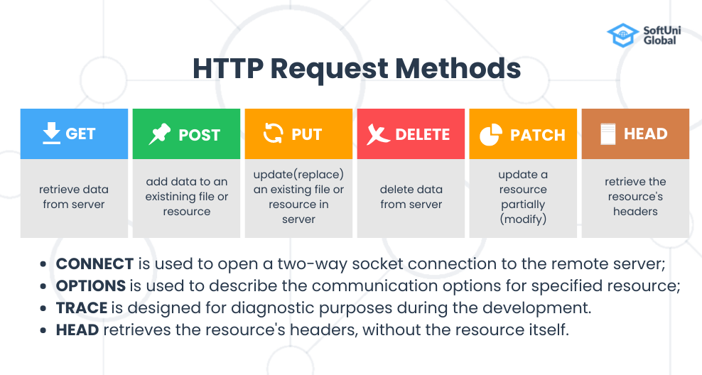

Slide 5
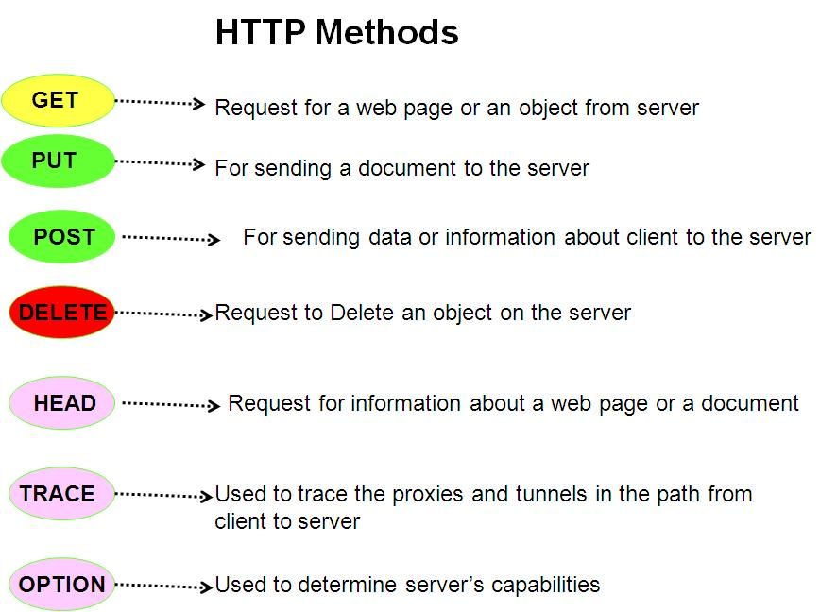

Slide 6
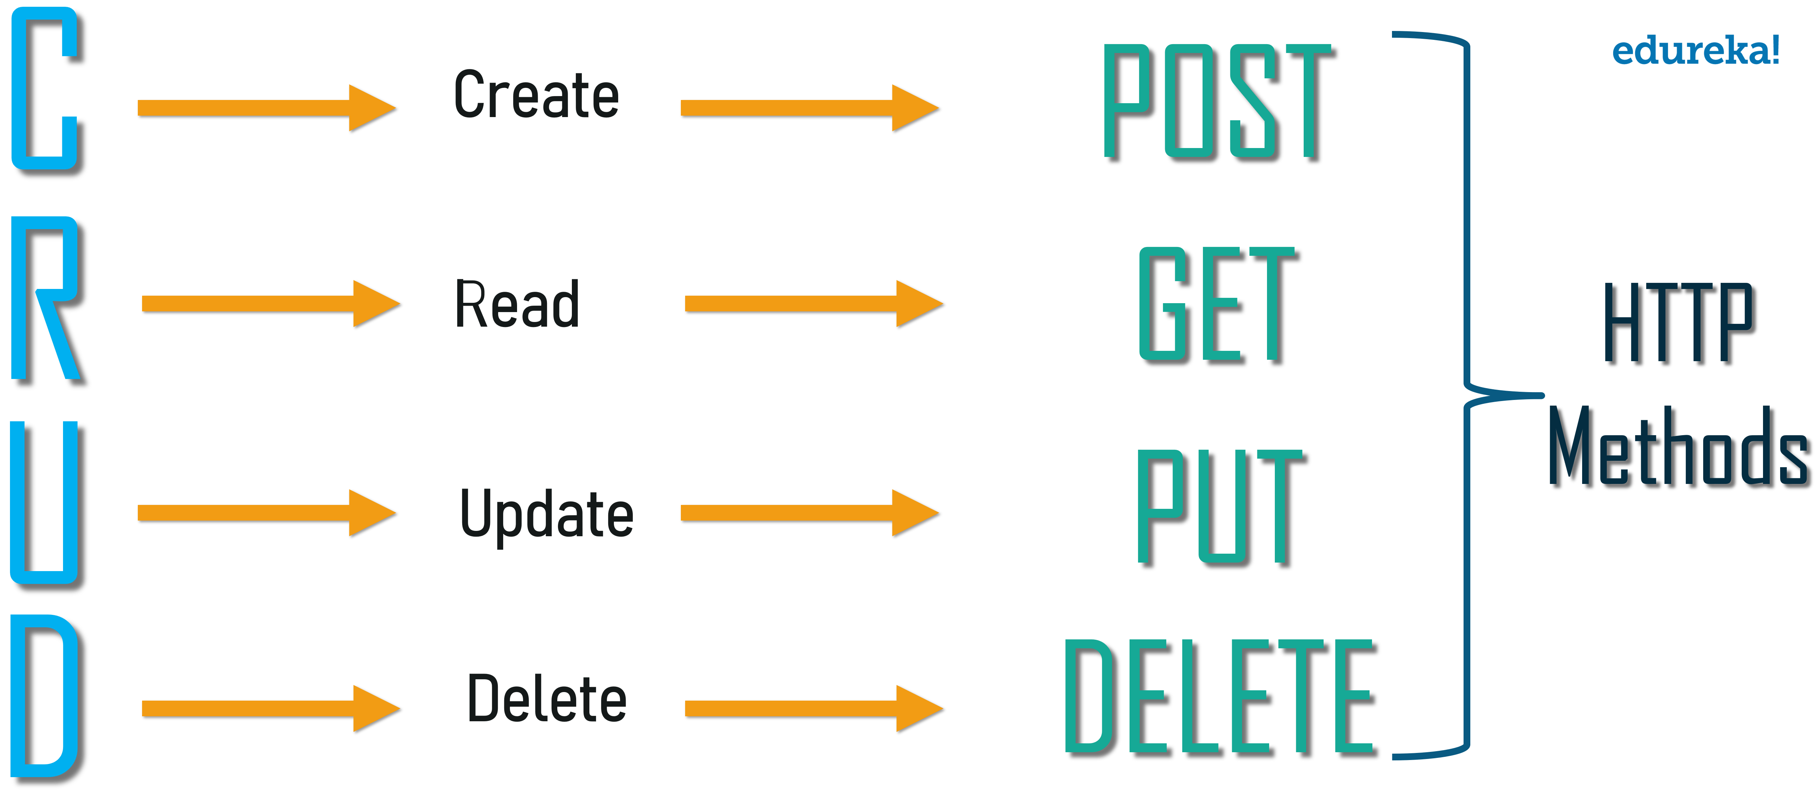

Slide 7
GET Method
GET is used to request data from a specified resource.
Some GET requests:
GET requests can be cached
GET requests remain in the browser history
GET requests can be bookmarked
GET requests should never be used when dealing with sensitive data
GET requests have length restrictions
GET requests are only used to request data (not modify)

Slide 8
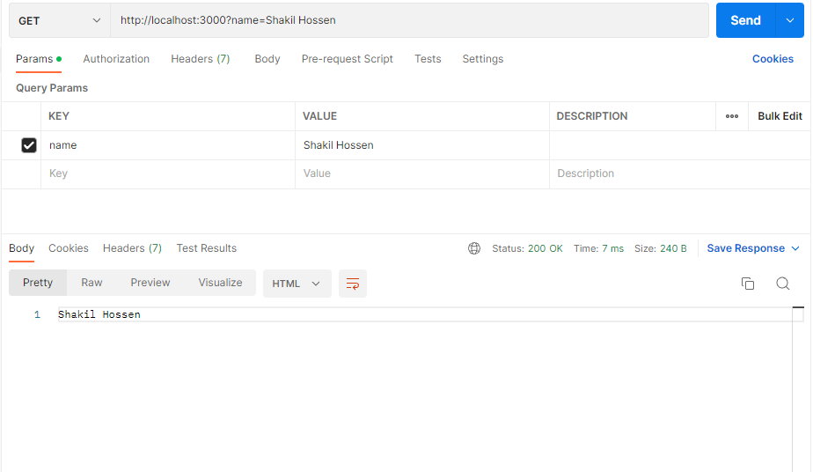
GET Method

Slide 9
POST Method
POST is used to send data to a server to create/update a resource.
Some notes on POST requests:
POST requests are never cached
POST requests do not remain in the browser history
POST requests cannot be bookmarked
POST requests have no restrictions on data length

Slide 10
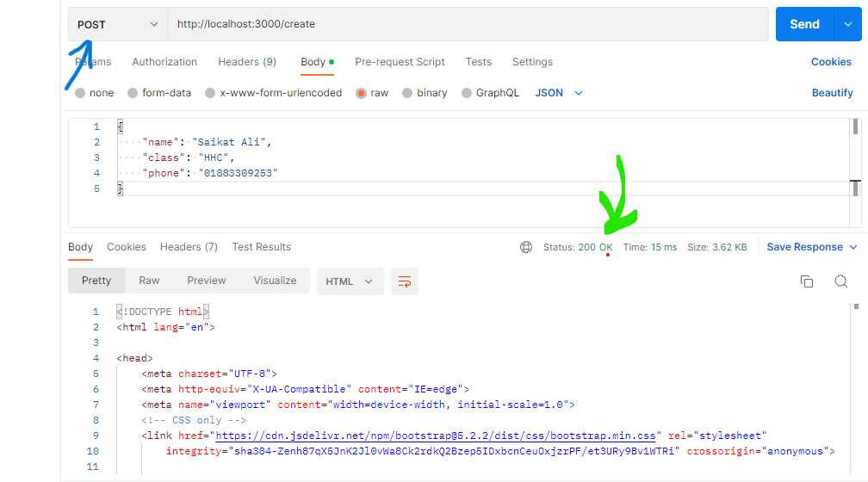
POST Method

Slide 11
GET & Post
The two most widely used methods to transfer user input data to the server are GET and POST methods.
GET method is used when relatively non-confidential information is passed. Once this information is submitted, you can see it in your browser’s URL. Additionally, the information can be cached as well. It is because of this reason the GET is not the best method to transfer confidential information.
On the other hand, POST method is used to transfer information which is relatively confidential and you do not want the browser to cache. One way to differentiate GET and POST methods is that you look in the URL.
If the information that you submitted is part of the URL, then it’s a GET method. If not, then it’s POST method.

